Slide 1


Social Buzz
“An analysis of content categories showing the top 5 categories with the largest popularity”

Slide 2


Today's agenda
Project recap
Problem
The Analytics team
Process
Insights
Summary

Slide 3

Social Buzz, a rapidly growing social media platform with over 500 million active users, seeks external expertise to navigate their upcoming IPO, manage their data-intensive operations, and adopt best practices for handling big data. They require an initial three-month project, including a big data audit, IPO preparation, and content category analysis, from an advisory firm. Tasks will involve creating best practice presentations, conducting on-site audits, extracting and analyzing data, and preparing for stress testing and technology workshops.
Project Recap

Slide 4

Problem
User post over 100,000 pieces of content every day.
With tens of millions of posts and hundreds of million of users, how do you capitalize?

Slide 5




Andrew Fleming
Chief Technology Architect
The Analytics team
Marcus Rompton
Senior Principal
Rohit Raman
Data Analyst

Slide 6
1. Requirements Gathering
Define project goals and gather business questions from stakeholders.
Business Question:
What is the top performing category?
How has the content type varied withing the top performing category?
How has the reaction type varied within top performing category?
How has the sentiment varied within the top 5 category?
How has the top performing category score change over time?
Process
1
2
2. Data Cleaning
Inspect, standardize, and correct errors in the provided data sets which are content, reactions, reaction types.
3
3. Data Modelling
Establish relationships between data sets (Content, reactions, reaction types) and create merged structures
4. Data Analysis
Perform exploratory analysis and visualize data to extract insights
4
5
4. Data Analysis
Perform exploratory analysis and visualize data to extract insights

Slide 7

Insights
Based on the questions provided, here's what I've brought as analysis:
Top-Performing Category: I identified the top-performing category by measuring the scores of various categories.
Content Type Variation within Top-Performing Category: I analyzed how different types of content (text, images, videos, GIFs) have varied within the top-performing category, highlighting the performance of each content type.
Reaction Type Variation within Top-Performing Category: I examined the variation of different reaction types (likes, dislikes, comments, and unique reactions) within the top-performing category, showing which reactions are most prevalent.
Sentiment Variation within Top 5 Categories: I investigated the sentiment (positive, negative, neutral) associated with the top 5 categories, providing insights into user feelings and attitudes towards content in these categories.
Performance of Top-Performing Category Over Time: I conducted a temporal analysis of how the score of the top-performing category has changed over time, identifying trends, growth, or decline.

Slide 8
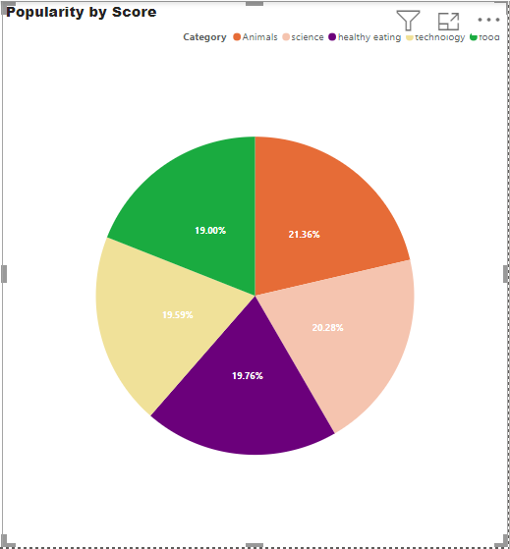
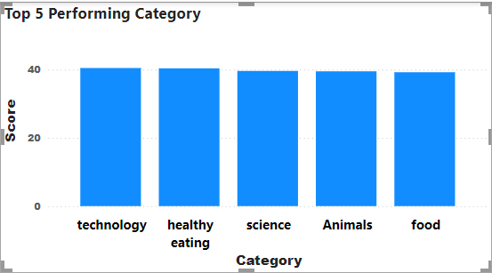
What are the top preforming category?
Observations:
Animal, science, healthy eating , technology, food are the top 5 most popular categories of content.

Slide 9
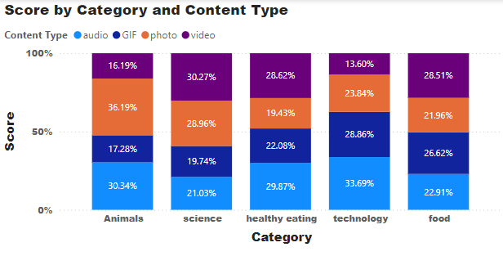
2. How has the content type varied within the top performing category?
Observations:
Photos, videos, and audio contributed the most to the top 5 categories, each scoring more than 20% across these categories

Slide 10
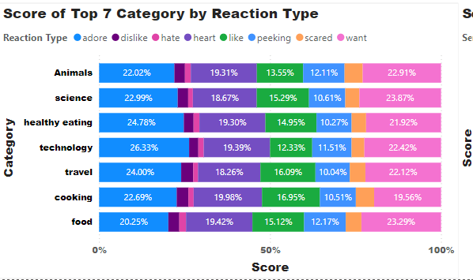
3. How has the reaction type varied within the top performing category?
Observations:
Reaction types such as adore, heart, like, and want contributed the most to popularity scores across all top 7 categories.

Slide 11
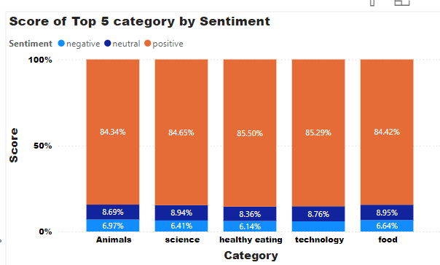
4. How has the sentiment varied within the top 5 categories?
Observations:
In all the top 5 categories, positive sentiment dominated, contributing more than 80 percent to the scores across all categories.

Slide 12
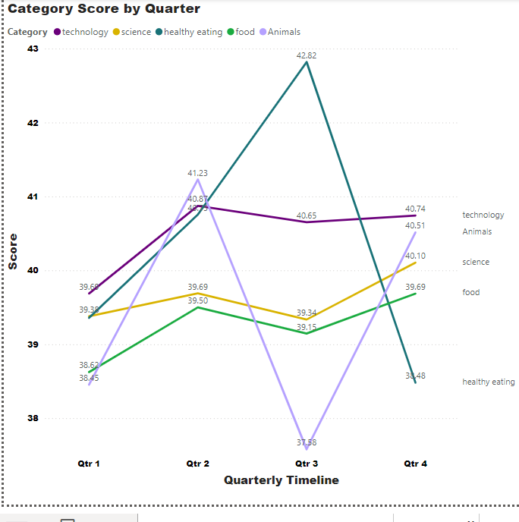
5. How has the top performing category score changed over time?
Observations: The highest average categories was found to be in the quarter 3 for healthy eating with a value of 42.62, the other peak could be seen for animals with a value of 41.23 for the quarter 2. However the least average score could be seen in the quarter 1 for all of the categories, which is the matter of further investigations.

Slide 13

Summary
Observations:
The analysis reveals that the most popular content categories are Animal, Science, Healthy Eating, Technology, and Food. These categories thrive particularly well through photos, videos, and audio, each contributing over 20% to the overall engagement in these categories. Reaction types such as adore, heart, like, and want significantly enhance popularity scores across all top seven categories, emphasizing the impact of positive interactions. Positive sentiment overwhelmingly dominates, contributing more than 80% to the scores in the top five categories. Seasonal trends also emerge, with Healthy Eating reaching its highest average score in Q3 (42.62) and Animals peaking in Q2 (41.23). This analysis underscores the significant role of engaging formats and positive reactions in driving the popularity of content in these leading categories, alongside notable seasonal peaks.

Slide 14
Summary
Next Steps:
Based on the above analysis, the next steps should be:
Optimize Content Strategy:
Focus on producing and promoting content in the top categories (Animal, Science, Healthy Eating, Technology, and Food) using engaging formats like photos, videos, and audio.
Enhance Positive Engagement:
Develop strategies to encourage positive reactions such as adore, heart, like, and want, and regularly monitor sentiment to maintain high positive feedback.
Seasonal Content Planning:
Plan and increase content production around seasonal peaks, emphasizing Healthy Eating in Q3 and Animal content in Q2 to maximize engagement.
Data-Driven Adjustments and Innovation:
Continuously analyze engagement metrics and audience feedback to fine-tune strategies, and experiment with new content ideas and formats to discover additional engagement drivers.

Slide 15
Summary

Slide 16
Thank you!
ANY QUESTIONS?

